Slide 1

Unit 4
Chemical Quantities
or
"Our Friend the Mole"

Slide 2
Unit 5 Overview
Major Vocabulary:
Major learning outcomes:
Any questions or connections?

Slide 3
What we will learn in this unit…
  You will be able to explain the significance and use of the mol
  You will be able to perform calculations involving the mole (grams <→ mole, particle ←> mole)
  You will determine relationships between molar quantities of gases at STP and perform associated calculations (gas ←> mole)
  You will calculate the percentage composition of each atom in a compound
  You will perform calculations involving molecular and empirical formulae to identify a substance
  You will describe concentration in terms of molarity and perform calculations involving molarity

Slide 4
5.1 and 5.2 (part 1) Preview
Read SWB pages 77-80
What are the key vocabulary term(s) in this section (5.1 and 5.2 part 1)?
Look at the Learning Outcomes for this section. Write down, in your own words if you can, the learning outcomes that this section of notes will cover?

Slide 5
How you measure how much?
You can measure mass, or volume, or you can count pieces.
We measure mass in grams.
We measure volume in liters.
We count pieces in MOLES.

Slide 6
Funny Mole Video
https://www.youtube.com/watch?v=PvT51M0ek5c
https://www.youtube.com/watch?v=Pft2CASl0M0

Slide 7
1 dozen donuts = 12 donuts
1 century = 100 years
1 millennium = 1000 years
1.00 mole = 6.02 x 10²³ particles
This is AVOGADRO’S NUMBER

Slide 8
The concept of the mole was first proposed by Amadeo Avogadro
He developed a method to convert between the mass of an element (in grams) and the number of atoms present
Recall that 1 mol = 6.02x10²³ atoms, ions, or molecules.

Slide 9
Avogadro decided to take 1.00 g of the smallest atom (H) and determined how many H atoms there are in 1.00 g of H.
He found that:
1.00 g H = 6.02 x 10²³ atoms = 1.00 mole
This is called Avogadro’s number

Slide 10
Atomic Masses
The atoms of different elements have different masses:
Since the mass of an atom is very small, we use a special unit to describe it…

Slide 11
In addition, we describe the masses of atoms using a relative scale:
We always compare them to the mass of carbon - 12

Slide 12
The mass of an atom, expressed with respect to the mass of Carbon-12 is called the ATOMIC MASS of the atom.
The experimentally determined mass of Carbon-12 is 12.011 amu (see periodic table).
What is the mass of Mg? 24.035 amu

Slide 13
Therefore the atomic mass of Mg is roughly 2 times larger than Carbon-12.
This is how we determine atomic masses; by relating them to the mass of Carbon-12

Slide 14
Therefore the measure of a mole is always the same...
1 mole = 6.02x10²³ atoms, molecules, ions, whatever!
For Example:
6.02x10²³ hydrogen atoms in 1.0g of hydrogen
6.02x10²³ lead atoms in 207.2 g of lead
6.02x10²³ gold atoms in 197.0 g of gold

Slide 15
Is 6.02x1023 a big number?
Think about this...
If I won a mole of dollars in the lottery that would be equal to:
$602,000,000,000,000,000,000,000.00

Slide 16
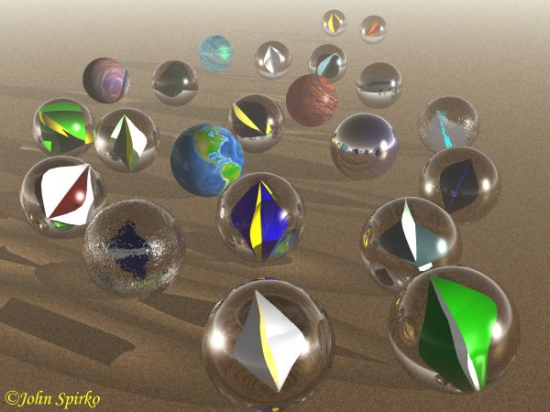
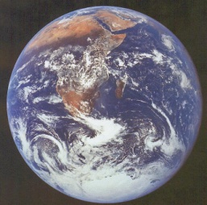
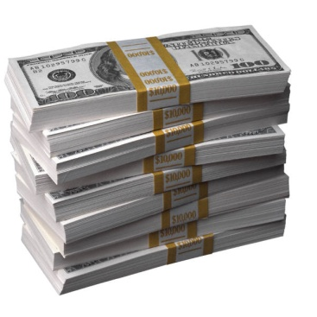
One mole of marbles would cover the entire Earth
(oceans included) for a depth of two miles.
One mole of $1 bills stacked
one on top of another would
reach from the Sun to Pluto
and back 7.5 million times.
It would take light 9500 years to travel from the bottom
to the top of a stack of 1 mole of $1 bills.

Slide 17
Molar Masses
of
Substances

Slide 18
The MOLAR MASS is the mass of one mole of a substance and is equal to the atomic mass, or molecular mass, expressed in grams.
More accurately, we can say:
The number of grams per mole of a substance written as g/mol.

Slide 19
When dealing with molar masses, only use ONE decimal place.
For example:
If the atomic mass is 34.254 amu, then the molar mass is 34.3 g/mol.

Slide 20
Molar Mass of Compounds
If we add up the masses of ALL the atoms that make up a compound, we can calculate the atoms MOLAR MASS.
For Example:
Find the molar mass of NaCl.
Steps:
1. Determine what atoms and their amounts are present.
NaCl = 1 Na + 1 Cl
2. Add up the individual masses of each atom present to
determine the molecular mass.
1 x Na = 23.0 g/mol
1 x Cl = 35.5 g/mol
1 x NaCl = 58.5 g/mol

Slide 21
What is the molar mass of Fe₂O₃?
2 moles of Fe x 55.85 g = 111.70 g/mol
3 moles of O x 16.00 g = 48.00 g/mol
= 159.70g/mol

Slide 22
Review four steps to calculating a substance's molar mass
Step One: Determine how many atoms of each different element are in the formula.
Step Two: Look up the atomic weight of each element in a periodic table.
Step Three: Multiply step one times step two for each element.
Step Four: Add the results of step three together and round off as necessary.

Slide 23
Special Note about Hydrates
Suppose you were asked to calculate the molar mass of CuSO₄ . 5H₂O
Remember that the dot DOES NOT mean multiply.
You could approach this two ways:
  Add the atomic weights of one copper, one sulfur, nine oxygens, and ten hydrogens.
  Add the atomic weights of one copper, one sulfur, and four oxygens. Then add the molecular weight of five H2O molecules.
The answer is 249.68 amu.

Slide 24
☺Assignment☺
SWB (Hebden workbook) page 80
# 6 (OL) and 7
Ex. a). NO
1 x 14= 14 g/mol
1 x 16= 16g/mol
=30 g/mol

Slide 25
5.2 (part 2) Preview
Read SWB pages 81-85
What are the key vocabulary term(s) in this section (5.2 part 2)?
Look at the Learning Outcomes for this section. Write down, in your own words if you can, the learning outcomes that this section of notes will cover?

Slide 26


Welcome to Mole Island
1 mol = molar mass
1 mole = 22.4 L
@ STP
1 mol =
6.02 x 10²³ particles

Slide 27
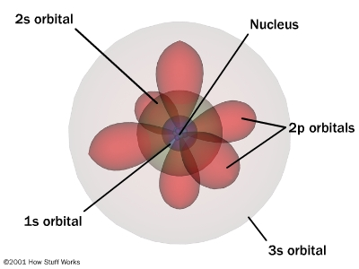

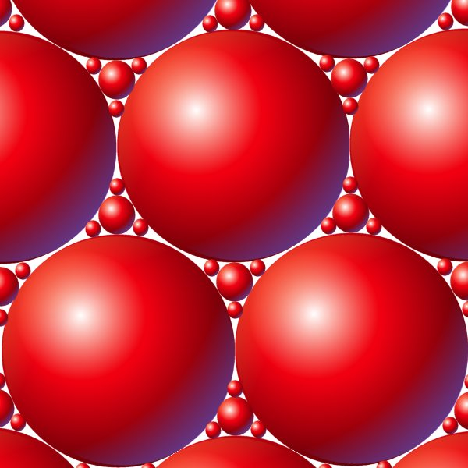
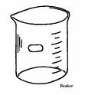

“Mole Island”
The number of specific
atoms
Grams
(g)
Particles
(atoms, molecules)
MOLE
Volume of a GAS at STP

Slide 28

“Mole Island”
The number of specific
atoms
1 molecule
# of ______ atoms
Grams
(g)
1 mol
Molar mass
1 mol
6.022 x 10²⁴
Particles
(atoms, molecules)
MOLE
1 mol
22.4 L
Volume of a GAS at STP

Slide 30
MOLE CONVERSIONS!!!

Slide 31
There are four steps to mole conversions:
Identify the Unknown and its units
Identify the Initial and its units
Identify the CF needed
Solve the problem
U= I x CF

Slide 32
Mole ↔ Grams
1 mol
molar mass
Add up the mass of each group of atoms in the species (ex. H₂O = 18.0 g/mol)

Slide 33
Gas Volume Calculations
1 mol
22.4 L
Avogadro’s Hypothesis states, “Equal volumes of different gases, at STP, contain the same number of particles.”
Standard Temperature and Pressure (STP) = OºC and 101.3 kPa.
Based on this information- 1 mole of ANY GAS at STP has a volume of 22.4 L.
Molar Volume of a gas is the volume occupied by one mole of the gas

Slide 34
Avogadro Number Calculations
1 molecule
# of ______ atoms
1 mol or
6.022 x 10²³
The value for Avogadro's Number is 6.022 x 10²³ mol⁻¹.
Types of problems you might be asked look something like these:
0.450 mole of Fe contains how many atoms?
0.200 mole of H2O contains how many molecules?
How many moles of N atoms are there in 5.00 x 10¹⁷ N atoms?
How many moles of CH4 molecules are there in 7.50 x10²⁵ CH4 molecules?

Slide 35
How Many Atoms in a given number of molecules?
Simply count the number of atoms in one molecule and then multiply by the number of molecules involved.

Slide 36
Example 1: How many moles of gas are contained in a balloon with a volume of 10.0 L at STP?

Slide 37
Example 1
U is # moles
I is 10.0 L
CF is 1 mole/22.4 L
U= 10.0 L x 1 mole
22.4 L
U = 0.446 mole

Slide 38
Example #2 - calculate how many grams are in 0.700 moles of H₂O₂
U = # grams
I = 0.700 moles H₂O₂
CF = 34.0 g/mole
# grams = 0.700 moles x 34.0 g
1 mole
# grams = 23.8 g H₂O₂

Slide 39
Example #3: 0.200 mole of H₂O contains how many molecules?
U = # molecules
I = 0.200 mole
CF = 6.02 x 10²³ molecules/mole
# molec = 0.200 mole x 6.02 x 10²³ molec
1 mole
# molec = 1.204 x 10²³ molecules

Slide 40
Example #4: 0.450 mole of Fe contain how many atoms?
U = # atoms
I = 0.450 mole
CF = 6.02 x 10²³ atoms/mole
# atoms = 0.450 mole x 6.02 x 1023 atoms
1 mole
# atoms = 2.709 x 10²³

Slide 41
Example 5: How many HYDROGEN atoms are there in 30 molecules of H₃PO₄?
# H atoms/molecule = 3
# molecules = 30
# H atoms = 3 x 30
= 90 atoms

Slide 42
Example 6: What is the volume occupied by 0.350 mol of SO₂(g) at STP?
U = # L SO2
I = 0.350 mol
CF = 22.4 L/mol
# L = 0.350 mol SO2 x 22.4 L
1 mol
# L SO2 = 7.84 L

Slide 43
Calculating Molar Mass of an Unknown Substance
?

Slide 44
Since the units for molar mass are g/mol, to find the molar mass of a substance given the mol and the grams, simply divide the grams by moles to obtain the molar mass ☺

Slide 45
☺Assignment☺
SWB:
Ex.) 8 (OL), 9 (OL), 10 (ALL) page 82
Ex.) 11 and 12 page 83
Ex.) #15 (b, d, and g) page 84, #23 (a, and b) page 87, #39 (e and f) page 89

Slide 46
5.3 Preview
Read SWB pages 85-90
What are the key vocabulary term(s) in this section (5.3)?
Look at the Learning Outcomes for this section. Write down, in your own words if you can, the learning outcomes that this section of notes will cover?

Slide 47

5-3 Multiple Conversions between Moles, Mass, Volume, and Number of Particles

Slide 48
When you are completing multiple conversions, you must remember the “mole” unit is CENTRAL to ALL conversions.

Slide 49
“Mole Island”
The number of specific
atoms
1 molecule
# of ______ atoms
Grams
(g)
1 mol
Molar mass
1 mol
6.022 x 10²⁴
Particles
(atoms, molecules)
MOLE
1 mol
22.4 L
Volume of a GAS at STP

Slide 50
Example 1: Calculate the number of O atoms in 250.0g of CO₂.
Note, there are 2 O's for each CO₂ molecule

Slide 51
250. g CO₂
Example 1: Calculate the number of O atoms in 250.0g of CO₂.
Note, there are 2 O's for each CO₂ molecule

Slide 52
250. g CO₂ x 1 mole
44.0 g
Example 1: Calculate the number of O atoms in 250.0g of CO₂.
Note, there are 2 O's for each CO₂ molecule

Slide 53
250. g CO₂ x 1 mole x 6.02 x 10²³ molec
44.0 g 1 mole
Example 1: Calculate the number of O atoms in 250.0g of CO₂.
Note, there are 2 O's for each CO₂ molecule

Slide 54
250. g CO₂ x 1 mole x 6.02 x 10²³ molec x 2 atoms O =
44.0 g 1 mole 1 molec CO₂
Example 1: Calculate the number of O atoms in 250.0g of CO₂.
Note, there are 2 O's for each CO₂ molecule

Slide 55
250. g CO₂ x 1 mole x 6.02 x 10²³ molec x 2 atoms O = 6.84 x10²⁴ atoms O
44.0 g 1 mole 1 molec CO₂
Example 1: Calculate the number of O atoms in 250.0g of CO₂.
Note, there are 2 O's for each CO₂ molecule

Slide 56
Example 2: What is the volume occupied by 50.0 g of NH₃ (g) at STP?
U = # L NH₃
I = 50.0 g NH₃
CF = 17.3 g/mol and 22.4 L/mol
# L NH₃ = 50.0 g x 1 mol x 22.4 L
17.3 g 1 mol
# L NH₃ = 66. 03 L NH₃

Slide 57
Example 3:
What is the mass of 1.00 x 10¹² atoms of Cl?
U = g of CI
I = 1.00 x 1012 atoms
CF = 6.02 x 1023 atoms/mol and 35.5 g/mol
# g Cl = ? (you tell me)

Slide 58
Example 4: How many oxygen atoms are contained in 75.0 L of SO3 (g) at STP?

Slide 59
☺Assignment☺
SWB:
Ex.) #21 on page 85, #35 page 88
Ex.) 22 (OL), 23 (OL), 24 (OL) pages 86 and 87

Slide 60
Calculations with Density
Read SWB pages 87 and 88
What are the 4 types of density problems?
Write out the PLANS for each type of problem (Look at the examples given)

Slide 61
☺Assignment☺
SWB:
Ex.) #25-30 and 34

Slide 62
5.4 Preview
Read SWB pages 90-91
What are the key vocabulary term(s) in this section (5.4)?
Look at the Learning Outcomes for this section. Write down, in your own words if you can, the learning outcomes that this section of notes will cover?

Slide 63
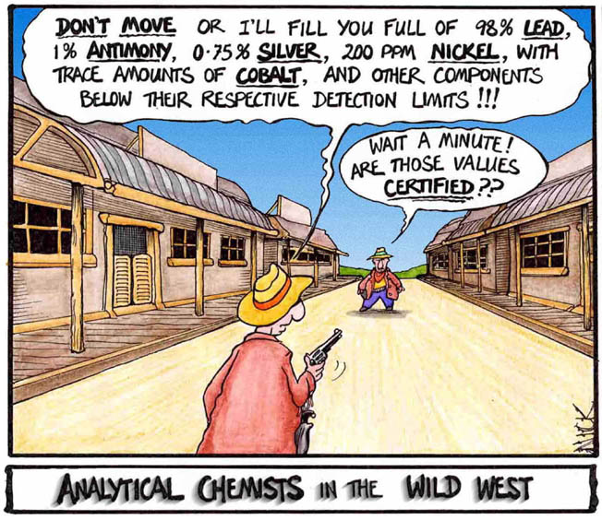

Slide 64
5- 4 Percent Composition
Percent composition is the percent by mass of each element present in a compound.

Slide 65
Example 1: H₂O
Figure out the molar mass from the formula.
One mole of water is 18.0 grams/mole
Figure out the grams each atom contributes by multiplying the atomic weight by the subscript.
H atoms = 2 x 1.0 = 2.0 grams of H in 1 mole of H₂O
O atoms = 1 x 16.0 = 16.0 grams of O in 1 mole of H2O.
Divide the answer for each atom by the molar mass and multiply by 100 to get a percentage.
% of “H” = 2.0 x 100% = 11.19%
18.0
% of “O” = 16.0 x 100% = 88.81%
18.0

Slide 66
Example 2: C₆H₁₂O₆
_{Lets do this together:}
    _{Meet me at the side chalkboard}

Slide 67
☺Assignment☺
SWB Ex.) 44 (OL) and 45 (OL) page 91

Slide 68
5.5 Preview
Read SWB pages 91-95
What are the key vocabulary term(s) in this section (5.5)?
Look at the Learning Outcomes for this section. Write down, in your own words if you can, the learning outcomes that this section of notes will cover?

Slide 69

Unit 5-5
Empirical Formula (EF) and
Molecular Formula (MF)

Slide 70
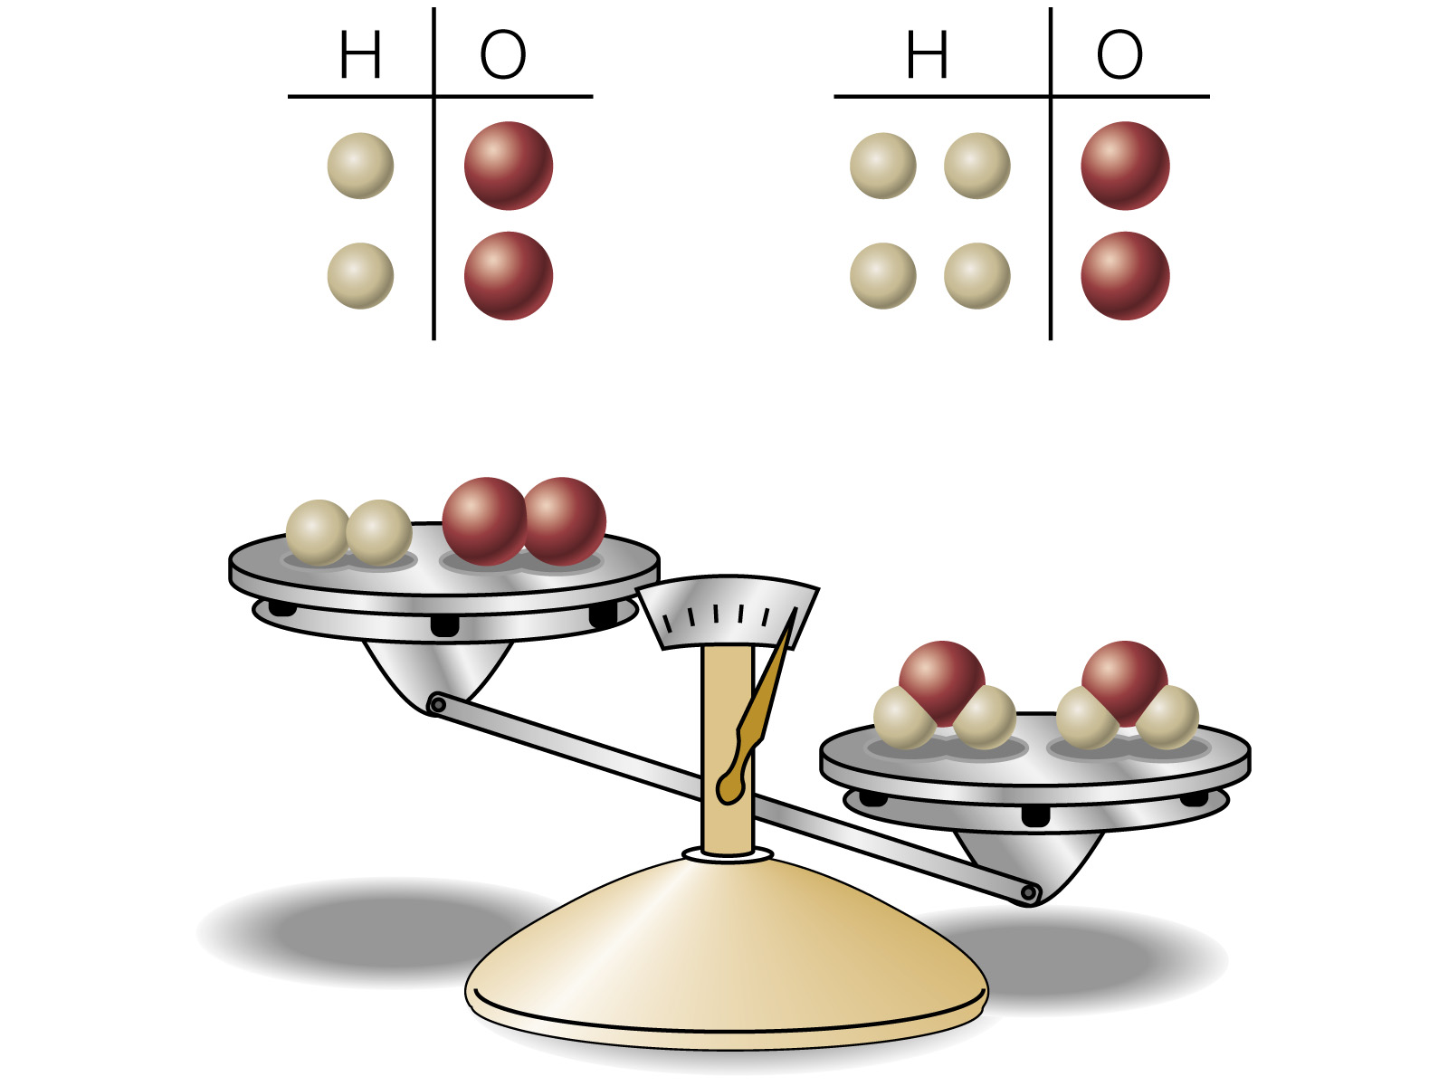
Empirical Formula

Slide 71
The empirical formula is the simplest whole
number ratio between atoms in a compound.
It is determined experimentally by measuring
the mass of the elements that combine to form
a compound.

Slide 72
Molecular Formula

Slide 73
Molecular Formula
Is the formula of the molecular unit

Slide 74
Molecular Formula
Is the formula of the molecular unit
Is a multiple of the empirical formula

Slide 75
Molecular Formula
Is the formula of the molecular unit
Is a multiple of the empirical formula
Molecular Formula
C₂H₆O₂
62.06 g/mol

Slide 76
Molecular Formula
Is the formula of the molecular unit
Is a multiple of the empirical formula
Molecular Formula Empirical Formula
C₂H₆O₂ CH₃O
62.06 g/mol 31.03 g/mol

Slide 77
Molecular Formula | Empirical Formula
H₂O | H₂O
CH₃COOH | CH₂O
CH₂O | CH₂O
C₆H₁₂O₆ | CH₂O

Slide 78
Notice two things
1. The molecular formula and the empirical formula can be identical.
2. You scale up from the empirical formula to the molecular formula by a whole number factor.

Slide 79
1. EF’s
There are 4 steps involved in calculating an empirical formula.
When teaching the method for converting percentage composition to an empirical formula, use the following rhyme:
Percent to mass
Mass to mole
Divide by small
Multiply 'til whole

Slide 80
Here's an example of how it works.
Example #1: A compound consists of 72.2% magnesium and 27.8% nitrogen by mass. What is the empirical formula?

Slide 81
(1) Percent to mass:
Assume 100 g of the substance, then 72.2 g magnesium and 27.8 g nitrogen.
(2) Mass to moles:
Mg: 72.2 g Mg x 1 mol Mg
24.3 g Mg = 2.97 mol Mg
N: 27.8 g N x 1 mol N
14.0 g N = 1.99 mol N
(3) Divide by small:
Mg: 2.97 mol
l.99 mol = 1.49
N: 1.99 mol
l.99 mol = 1.00
(4) Multiply 'til whole:
for Mg: 2 x 1.49 = 2.98 (i.e., 3)
for N: 2 x 1.00 = 2.00
The formula of the compound is Mg₃N₂

Slide 82
Example # 2: What is the empirical formula of a compound consisting of 80.0% C and 20.0% H?
Meet me at the side!

Slide 83
☺Assignment☺
SWB Ex.) 46 (OL) page 93

Slide 84
2. MF’s
Here's the example problem:
A compound is analyzed and found to contain 68.54% carbon, 8.63% hydrogen, and 22.83% oxygen. The molecular weight of this compound is known to be approximately 140 g/mol. What is the empirical formula? What is the molecular formula?

Slide 85
First Determine the EF:
(1) Percent to mass. Assume 100 grams of the substance is present, therefore its composition is:
carbon: 68.54 grams
hydrogen: 8.63 grams
oxygen: 22.83 grams
(2) Mass to moles. Divide each mass by the proper atomic weight.
carbon: 68.54 / 12.011 = 5.71 mol
hydrogen: 8.63 / 1.008 = 8.56 mol
oxygen: 22.83 / 16.00 = 1.43 mol
(3) Divide by small:
carbon: 5.71 ÷ 1.43 = 3.99
hydrogen: 8.56 ÷ 1.43 = 5.99
oxygen: 1.43 ÷ 1.43 = 1.00
(4) Multiply 'til whole. Not needed since all values came out whole.
The empirical formula (EF) of the compound is C₄H₆O

Slide 86
Next we need to determine the molecular formula, knowing the empirical formula and the molecular weight (will always be given in the question or calculate it from dividing grams by moles….which would be given!!).

Slide 87
Here's how:
1) Calculate the "empirical formula weight." This is not a standard chemical term, but it is understandable.
C₄H₆O gives an "EFW" of 70.092
2) Divide the molecular weight by the "EFW"
140 ÷ 70 = 2
3) Multiply the subscripts of the empirical formula by the factor just computed.
2(C₄H₆O)= C₈H₁₂O₂
This is the molecular formula.

Slide 88
Example #2: A molecule has an empirical formula of HO and a molar mass of 34.0 g. What is the molecular formula?

Slide 89
Example #3: The empirical formula of a compound is SiH₃. If 0.0275 mol of compound has a mass of 1.71g, what is the compound’s molecular formula?

Slide 90
☺Assignment☺
SWB Ex.) 47-52, 54 page 95

Slide 91
5.6 Preview
Read SWB pages 96-104
What are the key vocabulary term(s) in this section (5.6)?
Look at the Learning Outcomes for this section. Write down, in your own words if you can, the learning outcomes that this section of notes will cover?

Slide 92
5-6 Molar Concentrations
(liquid volumes):
Molar Concentration: M = moles
Volume
These calculations are important for working with solutions of different concentrations
Knowing the concentrations of a solution provide a way to find how much of a particular substance exists in a given volume of the solution
Molar Concentration or Molarity (“M”) of a substance in solution is the number of moles of the substance contained in 1 L of solution.

Slide 93
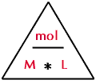
In order to perform these calculations you must be in the units of moles and litres.

Slide 94
Example 1: If 2.0 L of solution contain 5.0 mol of NaCl, what is the molarity of the NaCl
Identify the unknown amount and its units
Identify the initial amount and its units (complete any initial conversions in order to have units in moles and / or litres)
Derive the conversion statement or factor
Put everything together in a complete unit conversion

Slide 95
Example 2: What is the [NaCl] in a solution containing 5.12 g of NaCl in 250.0 mL of solution?

Slide 96
Example 3: What mass of NaOH is contained in 3.50 L of 0.200 M NaOH?

Slide 97
☺Assignment☺
SWB Ex.) 59 – 64 page 91

Slide 98
Dilution Calculations:
Text pages 99 – 102
When two solutions are mixed, the resulting mixture has a total volume and total number of moles equal to the sum of the individual volumes and individual number of moles of chemical found in the separate solutions
M1V1 = M2V2
M1= initial concentration of solution (in more concentrated form)
V1 = initial volume of solution (in more concentrated form)
M2=diluted concentration (after water is added)
V2 = diluted volume (after water is added) ** can be thought of as the TOTAL volume after dilution

Slide 99
Example #1: If 200.0 mL of 0.500 M NaCl is added to 300.0 mL of water, what is the resulting [NaCl] of the mixture?

Slide 100
Example #2: ** A question may also may mix TWO different solutions having different concentrations of the same chemical!
** HINT: 2 volumes and 2 […]’s

Slide 101
If 300.0 mL of 0.250 M NaCl is added to 500.0 mL of 0.100 M NaCl, what is the resulting [NaCl] in the mixture?
** In this case you will need to carry out two separate sets of calculations for each initial M1 [NaCl] and then add the two new M2 together for your final answer.

Slide 102
 | Let solution #1 be 0.250 M NaCl | Let solution #2 be 0.100 M NaCl
Unknown amount?
Initial Amount(s)?
Rearrange formula to solve for unknown:
Solve for the problem:
Add [NaCl] total

Slide 103
Example #3: What volume of 6.00 M HCl is used in making up 2.00 L of 0.125 M HCl?

Slide 104
Example #4: A student mixes 100.0 mL of water with 25.0 mL of a NaCl solution having an unknown […]. If the student finds the molarity of the NaCl in the diluted solution is 0.0876 M, what is the molarity of the original NaCl solution?

Slide 105
Example #5: How would you prepare 250.0 mL of 0.350 M NaOH , starting with 6.00 M NaOH?

Slide 106
☺Assignment☺
SWB Ex.) 72-77 page 99-100
SWB Ex.) 78-83, 86, 87, 89 page 102
SWB Ex.) 95, 96, 97 (OL), 99, 100 and 101 pages 103-104.

